Slide 1
Evaluation of deep reinforcement learning and its application through a case study in computer games
Student: John Gregg-Webster.
Supervisor: Feng Dong.
Second Marker: Kieren Egan.
Marking Scheme: Experimentation-based with Significant Software Development.

Slide 2
Aims and Objectives
Compare the effectiveness of deep reinforcement learning strategies.
Implement games suitable for the application of DRL techniques.
Implement DRL agents, covering a variety of algorithms.
Compare the performance of those agents.

Slide 3
Specification
Measurements
For each model.
Total return for each epoch of training (visualized with moving average).
Min, mean, max return of final models after 100 iterations.
Identical & documented hyperparameters.
Fixed random seeds.
Return visualisations will include a human score for comparison.
Environments
Aiming for at least three.
Single-agent grid world.
Multi-Agent Board Game (connect 4).
Continuous Action Space Environment (TBD).
Agents
Policy Gradient (REINFORCE, Proximal Policy Optimization)
Q-Value (SARSA, DQN).
Actor-Critic (Basic, A2C, A3C).
Notes:
The size of the moving average is going to depend on the number of epochs, so that will have to be decided later. It’ll be the same for all agents.
Training durations depends on the environment, will just be training until all algorithms have converged sufficiently.
Fixed seeds for replicability.

Slide 4
Agents & Environments
Notes:
Subject to change.
Maze idea is much too complicated. Most likely going to be a simpler single-agent grid world.
Board game (connect 4). Implemented tic-tac-toe to test out multi-agent setup, but that one’s not complicated enough to be interesting.
Continuous Environment (no sure what, possible racing based).
Further research is needed to see how complicated this is.

Slide 5
Output Format
Policy-Based
No values assigned to states or actions.
The policy distribution is learned directly.
Output distribution can be sampled from to enact policy.
V-Value-Based
The value of states is learned.
That is, a number that correlates with the actual future reward from that state.
Requires transition model.
Q-Value-Based
Learn the value of actions in states.
Correlates with future reward of the states reached after action.
Does not require a transition model.
Notes:
Policy-based.
You don’t have to sample policy distribution, or sample uniformly. That’s just one way.
Actor-critic methods have the same interface (they map states to a probability distribution). But the method by which they learn is significantly different.
Why not just output the action directly? Non-continuous action space = no gradient.
Actor-Critic methods, sort of in-between (policy-based output, but use Q-value critic to learn).

Slide 6
Exploration Methods
Temporal Difference
Parameters are updated according to individual transitions between states.
Bootstrapping is possible.
Model-Free possible.
Monte Carlo
Parameters are updated at end of epochs according to final return.
Simple sum of rewards, discounted, etc.
No bootstrapping.
Model-Free possible.
Dynamic Programming
Full iteration of states & action spaces.
Parameters are updated according
Only model-based.
Not very realistic.
Notes:
Dynamic programming requires certain conditions that make it inappropriate for many actual problems.
Requires dynamics model, not appropriate for i.e. real physical environment.
Finite state & action spaces, not appropriate for i.e. solving a puzzle cube, continuous function approximation.

Slide 7
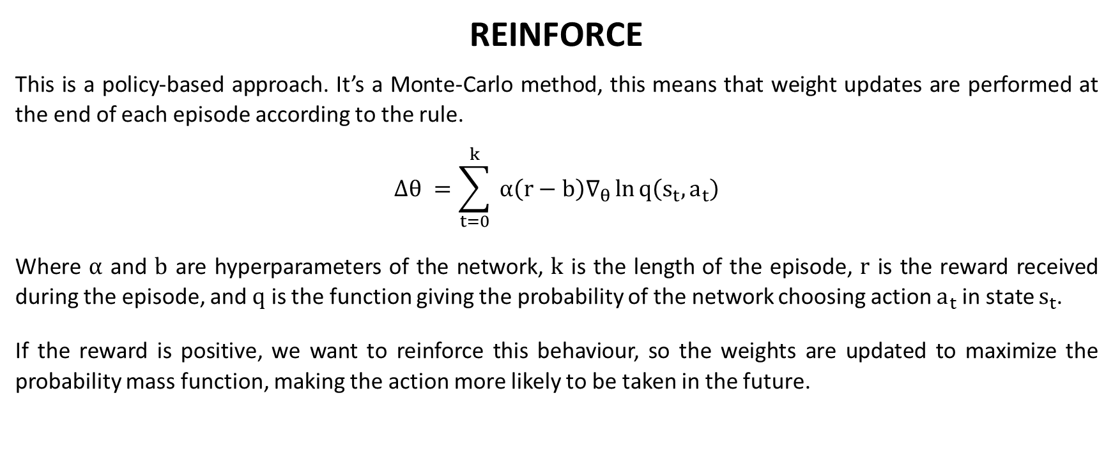
Policy-Gradient Methods
REINFORCE
This is a policy-based approach. It’s a Monte-Carlo method, this means that weight updates are performed at the end of each episode according to the rule.
$$∆θ =\sum_{t=0}^{k}{ α\left(r−b\right)∇_{θ}\ln{q\left(s_{t},a_{t}\right)}}$$
Where $α$ and $b$ are hyperparameters of the network, $k$ is the length of the episode, $r$ is the reward received during the episode, and $q$ is the function giving the probability of the network choosing action $a_{t}$ in state $s_{t}$.
If the reward is positive, we want to reinforce this behaviour, so the weights are updated to maximize the probability mass function, making the action more likely to be taken in the future.
Notes:
$s_{t}, a_{t}$ are the actual actions taken at $t$ (on-policy). In practice the entire eligibility gradient is calculated and stored.
Update rule from: 1. (Williams).

Slide 8


Q-Value Methods
DQN $$L(s_{t},a_{t},r_{t},s_{t+1}) = E_{\text{ρ}}\left[{\left(r_{t} +\begin{matrix}max \\ a\end{matrix}Q_{θ}\left(s_{t+1,}, a\right) − Q_{θ}\left(s_{t},a_{t}\right)\right)}^{2}\right]$$
Off-policy.
Experience replay is possible.
SARSA
$$L(s_{t},a_{t},r_{t},s_{t+1},a_{t+1}) = E_{\text{ρ}}\left[{\left(r_{t} +Q_{θ}\left(s_{t+1}, a_{t+1}\right)− Q_{θ}\left(s_{t},a_{t}\right)\right)}^{2}\right]$$
On-policy.
Cannot make use of experience replay.
Notes:
This is the method from the 2013 DQN/Atari paper.
Where ρ is the transition model.
Note that the two functions are identical except the first Q, the future estimate.
Optimise for a different loss function each step, as some of the terms in the function are dependent on theta.
Explain experience replay.
Transitions (s,a,r,s) from the environment are retained in memory.
Replayed, trained on them.
Cannot be applied to SARSA. The resulting algorithm would be off-policy and no longer considered SARSA. Tested it out, sort of works but performance is very unstable.
Loss functions from: 2. (Mnih et al).

Slide 9
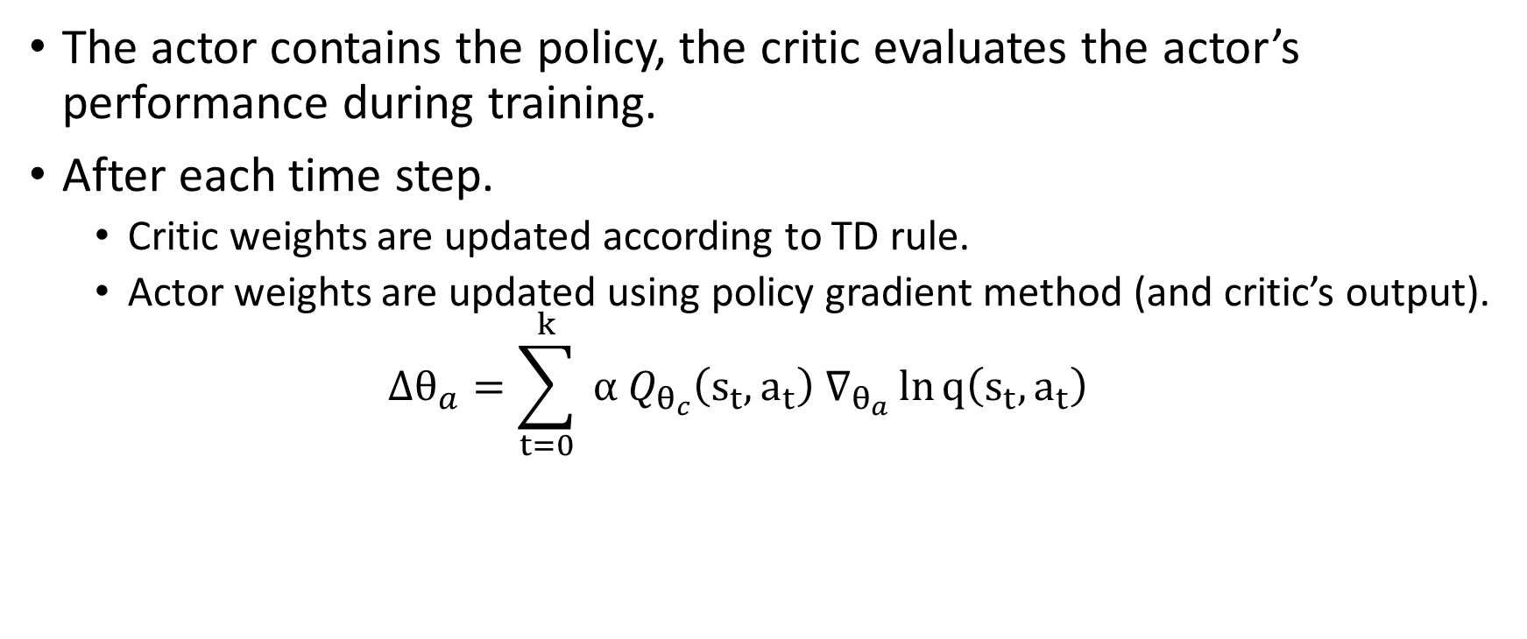
Actor-Critic
The actor contains the policy, the critic evaluates the actor’s performance during training.
After each time step.
Critic weights are updated according to TD rule.
Actor weights are updated using policy gradient method (and critic’s output).
$$∆θ_{a}=\sum_{t=0}^{k}{ α Q_{θ_{c}}\left(s_{t},a_{t}\right) ∇_{θ_{a}}\ln{q\left(s_{t},a_{t}\right)}}$$
Notes:
There are some other variants of this algorithm I’d like to cover (A3/3C) that add optimisations, but I haven’t really got around to covering them yet.

Slide 10
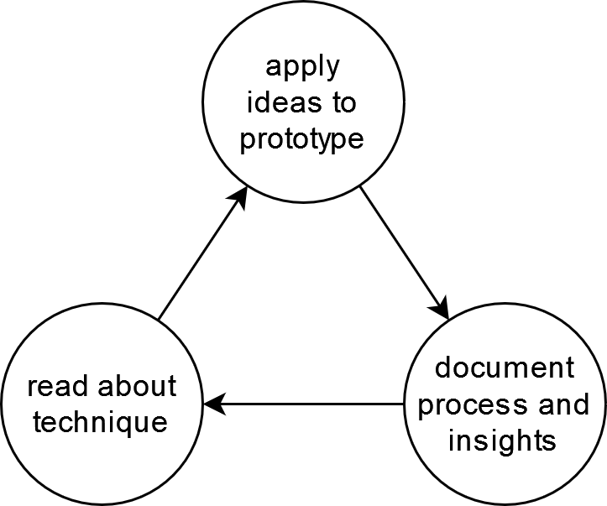
Methodology
Following AGILE principles.
Sprints for research, writing, prototyping.
Notes:
Prototyping, ran out of slides for this.
Related work is still incomplete but coming along nicely.
I’ve got working implementations for DQN, SARSA, REINFORCE, a basic Actor-Critic implementation.
They work well on cartpole and the two test environments I’ve made (grid world & tic-tac-toe).

Slide 11
References
R. J. Williams, “Simple Statistical Gradient-Following Algorithms for Connectionist Reinforcement Learning,” Machine Learning, vol. 8, p. 229–256, 1992.
V. Mnih, K. Kavukcuoglu, D. Silver, A. Graves, I. Antonoglou, D. Wierstra and M. Riedmiller, “Playing Atari with Deep Reinforcement Learning,” arXiv preprint arXiv:1312.5602, 2013.
A. Novikoff, “On Convergence Proofs For Perceptrons,” Proceedings of the Symposium on the Mathematical Theory of Automata, vol. 12, no. 1, pp. 615-622, 1963.
P. Dayan and C. J. Watkins, “Q-Learning,” Machine Learning, vol. 8, pp. 279-292, 1992.
M. Hessel, J. Modayil, H. van Hasselt, T. Schaul, G. Ostrovski, W. Dabney, D. Horgan, B. Piot, M. Azar and D. Silver, “Rainbow: Combining improvements in deep reinforcement learning,” Proceedings of the AAAI conference on artificial intelligence, vol. 32, no. 1, 2017.
V. Konda and J. Tsitsiklis, “Actor-Critic Algorithms,” Advances in neural information processing systems, vol. 12, 1999.
R. S. Sutton and A. G. Barto, Reinforcement Learning: An Introduction, Second Edition, MIT Press, 2018.

